Slide 2
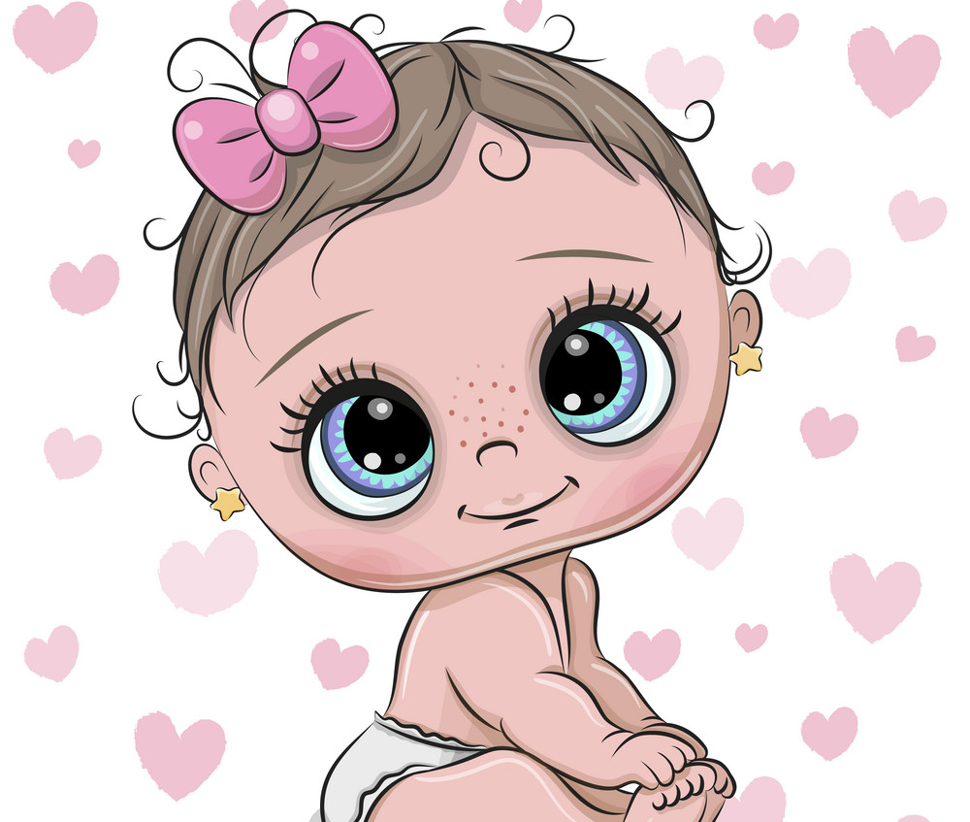
Ages when Singers got their start
Taylor Swift – 16
Brittney Spears – 14
Rihanna – 15
Michael Jackson – 8
Elvis Presley – 13
Katy Perry – 15
Billie Eilish – 15
Justin Beiber - 13

Slide 3
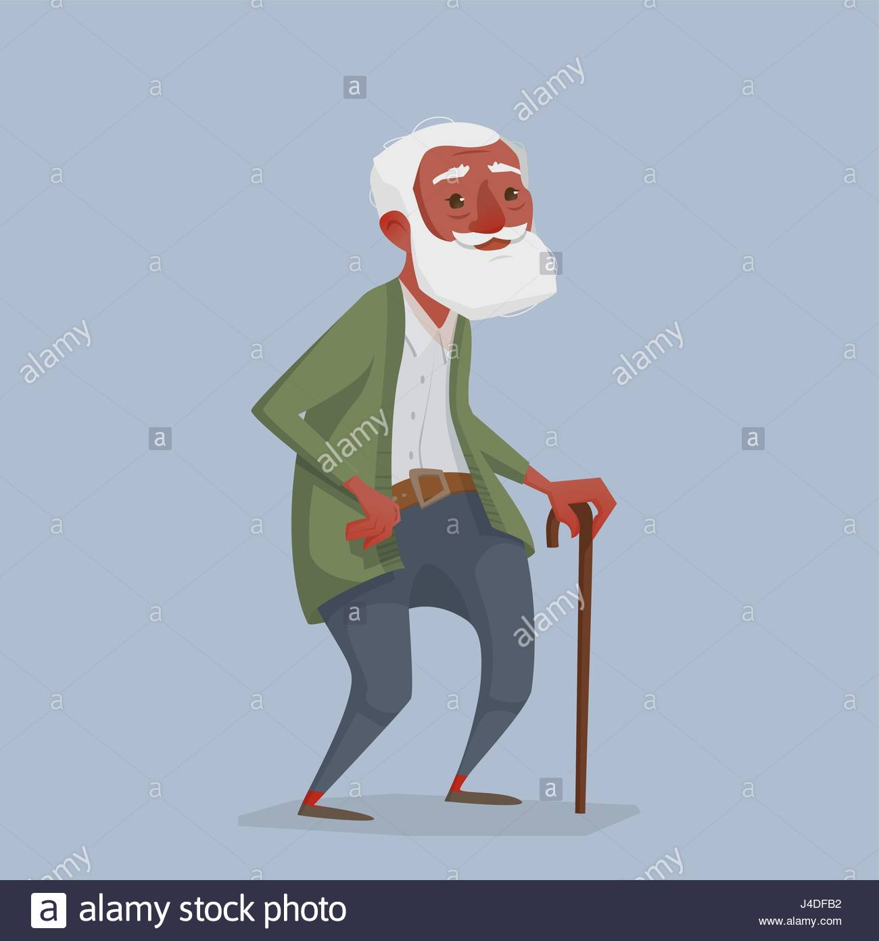
Age when Bill Withers got his start : 32

Slide 4
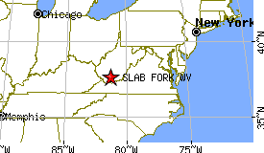
Bill Withers Home Town
William Harrison Withers was born on July 4, 1938 in Slab Fork, West Virginia. Population today : 202.
He was the youngest of six children.

Slide 5
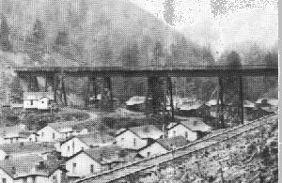
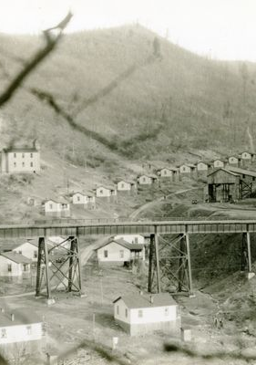
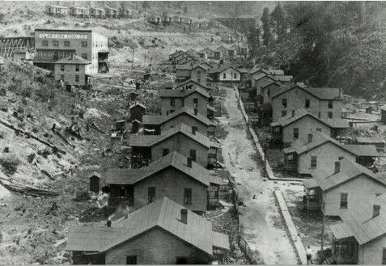
Bill Withers Childhood
His father was a coal miner. He died when Bill was 13 years old. There were railroad tracks that went right through the middle of town. Whites lived on one side of the track and African Americans lived on the other side. Bill Withers said “Even though I saw racism, I was able to play with both white and black children. Because everyone was a coal miner, I would always say ‘When everyone comes out of the mines, they are all black.’”

Slide 6
Grandma’s Hands
Bill worked various jobs to help support his family. He was raised by both his mother and his grandmother – and later wrote a famous song for her called Grandma’s Hands.

Slide 7
Bill Joins the Navy
At the age of 17, Bill joined the United States Navy, where he would serve for nine years.
In the Navy he learned about airplanes and engineering.

Slide 8
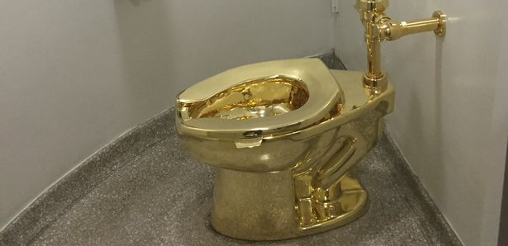
Bill Takes on various jobs including as a milkman and toilet maker.
When he got out of the Navy, he moved to Los Angeles.
He worked at various jobs including as a milkman.
His dream was to work in the music industry. He bought his first guitar when he got out of the army and played for free in clubs and paid to record his songs himself
He got a job in the Douglass Aircraft Corporation making toilets for 747 style airplanes.
It was during this time, at the age of 31, that Bill wrote his famous song “Ain’t no Sunshine”
When the song went “gold” (selling 500,000 copies) his music company gave Bill a golden toilet seat, marking the start of his new career.[

Slide 9
Bill overcomes his stuttering – Ain’t No Sunshine
Bill talked about his stuttering problem that he had as a child all the way up to age 28 years old.
Quote: “I figured out that my stutter — and this isn’t the case for everyone — was caused by fear of the perception of the listener. I had a much higher opinion of everyone else than I did of myself. I started doing things like imagining everybody naked — all kinds of tricks I used on myself.”
When he was writing Ain’t no Sunshine, he repeats the line “I know” numerous times. He was going to write more words, but people told him not to. He thought it was a good reminder to himself about his stuttering problem.

Slide 10
Hits after Ain’t no Sunshine
Grandma’s Hands - 1971.
Lean on Me – 1972
Use Me – 1972
Lovely Day – 1977
Just the Two of Us - 1978

Slide 11
But then…
Withers small music company called Sussex Music went out of business and his music deal was transferred to giant music company Columbia Records.
The first executive at the big new company said to him “I don’t like your music or any black music, period”.
They told him his songs needed longer introductions.
They told him what instruments to put in his songs.
They told him he should re-make some of Elvis Presley’s songs (even though he was a songwriter).

Slide 12
So, he walked away…
He never wrote another note after 1979.
He never performed in publicly in a concert after the year 1985.
He walked away from fame.
He walked away from money.
Articles were written and people couldn’t understand why.

Slide 13
Bill Withers: The Soul Man Who Walked Away from Fame!!
Read the Article here: https://www.rollingstone.com/music/music-news/bill-withers-the-soul-man-who-walked-away-111535/

Slide 14
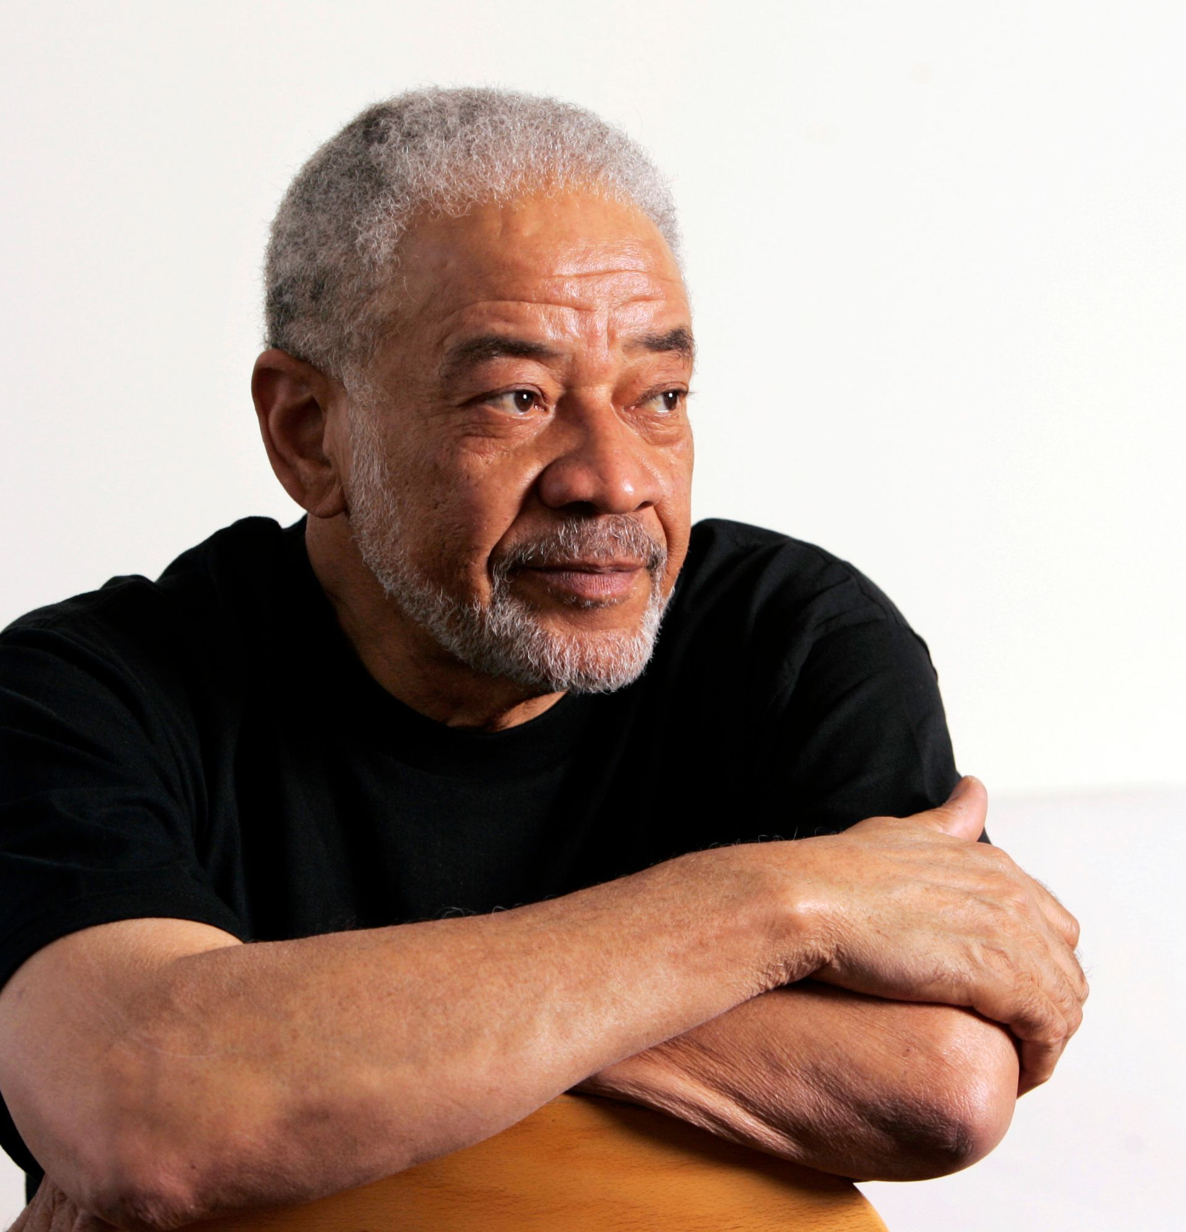
Quotes:
“What else do I need to buy?” he says. “I’m just so fortunate. I’ve got a nice wife, man, who treats me like gold. I don’t deserve her. My wife dotes on me. I’m very pleased with my life how it is. This business came to me in my thirties. I was socialized as a regular guy. I never felt like I owned it or it owned me.”
“What few songs I wrote during my brief career, there ain’t a genre of music that somebody didn’t record one of my songs in. I’m not a virtuoso, but I was able to write songs that people could identify with. I don’t think I’ve done bad for a guy from Slab Fork, West Virginia.”

Slide 15
Thanks Bill!!!

