Slide 2
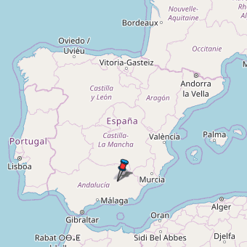
Belmez, Spain
Sun-drenched, temperate, and jutting into the Mediterranean Sea, Andalusia is the embodiment of southern Spanish charm. The province of Jaén, along the northeastern border of Andalusia, is the cradle of Spain’s olive oil production, attracting visitors near and far. But nestled amid its rocky peaks is a village with a sinister reputation.

Slide 3
Bélmez de la Moraleda has a population of around 2,000 people.

Slide 4
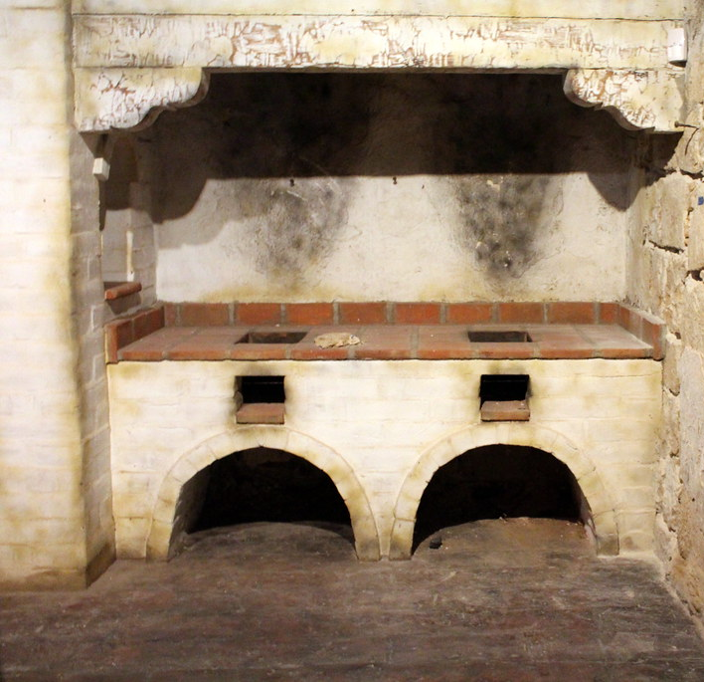
Maria Gomez Pereira
One day in 1971, resident María Gómez Pereira noticed an unusual stain on the concrete floor of her kitchen. It darkened the next day, slowly taking shape—until the face of a man emerged.

Slide 5
The face appeared on the floor of the kitchen

Slide 6
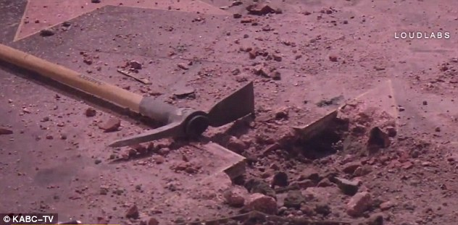
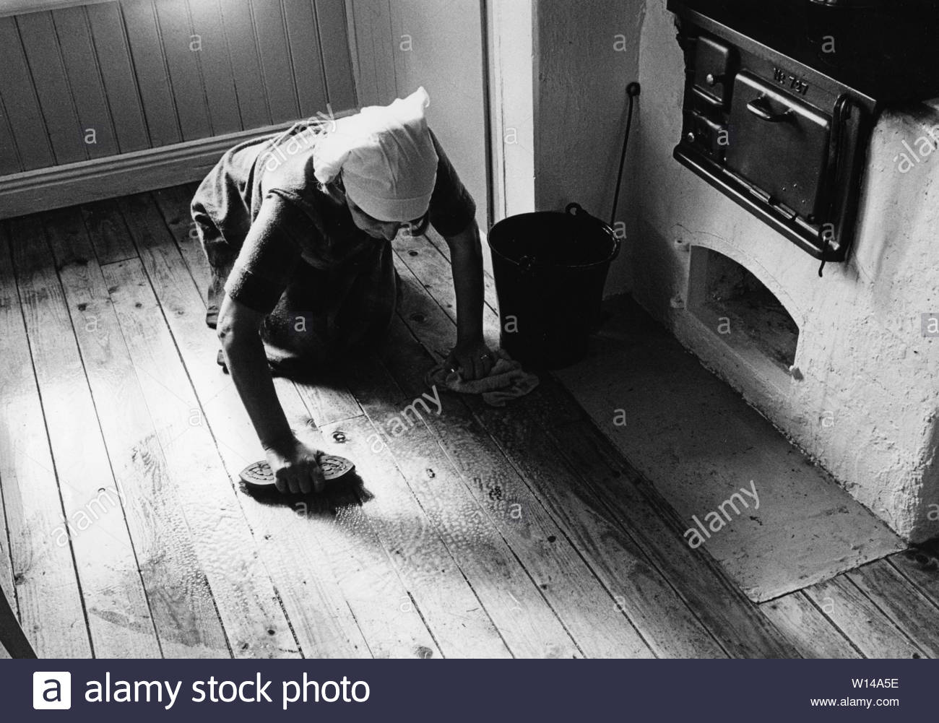
Get it out of here!
Frightened, María tried to scrub it away—but to no avail. The mysterious face would not leave. Her husband decided to destroy the stain completely. With a pick ax, he busted up the floor and its haunting visage. New concrete was laid and a sense of normalcy returned.

Slide 7
That is, until the face resurfaced a week later.

Slide 8
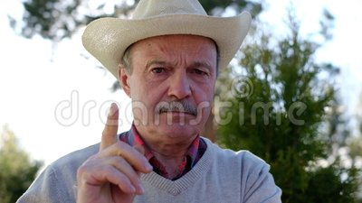
Let’s figure this out!!
Word spread quickly in the small town. Neighbors stopped by to inspect the strange phenomenon in the Pereira household. Soon, the family was the center of attention. All they wanted was an end to whatever force had crept into their home. But before they could destroy the face for a second time, the town’s mayor declared that the site should be excavated for study.

Slide 9
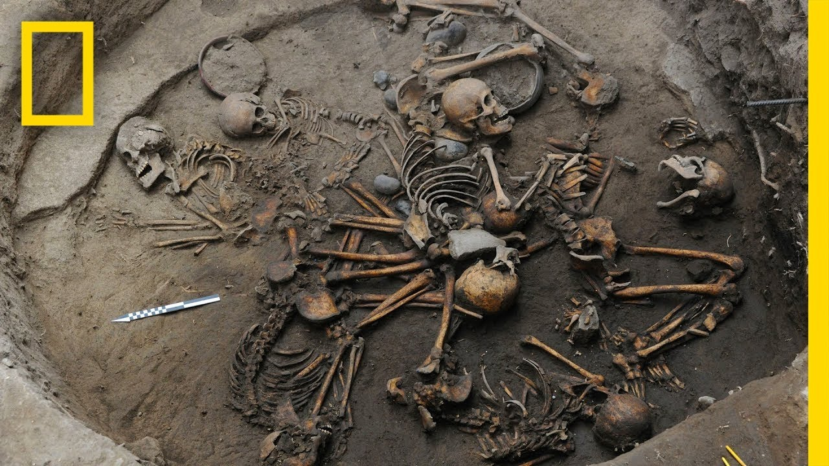
Oh my! Look what we found!
The dig went deep into the earth, pulling up the concrete floor and the ancient foundation beneath. What they reportedly uncovered shocked everyone—skeletons lay at rest in the ground beneath the kitchen. The corpses were exhumed and studied. Researchers concluded that some dated back to the 13th century.

Slide 10
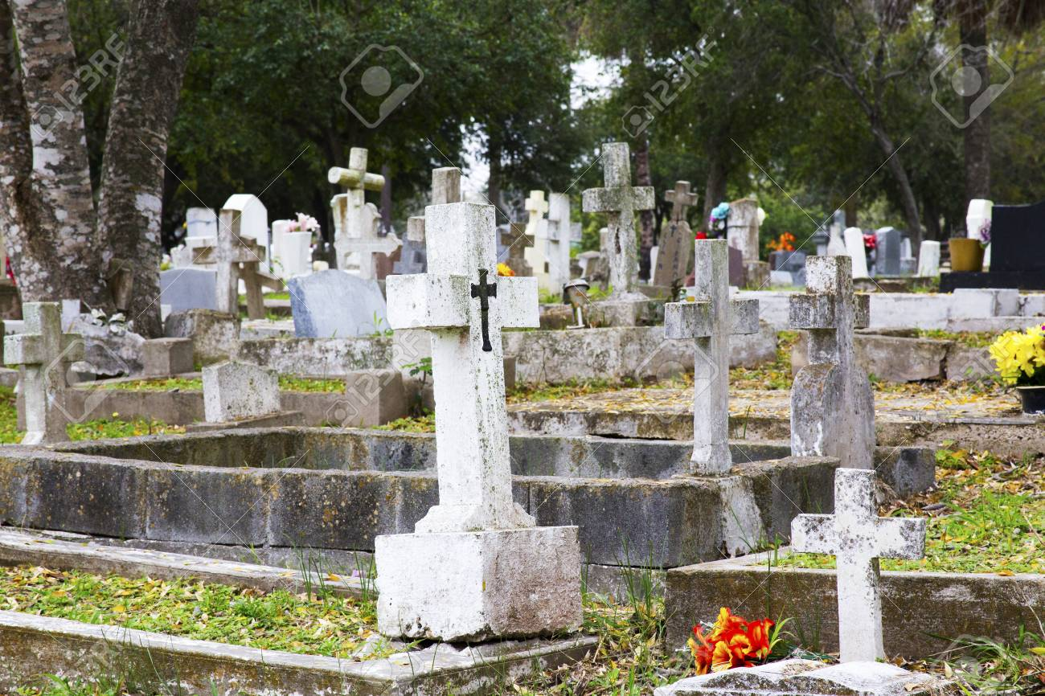
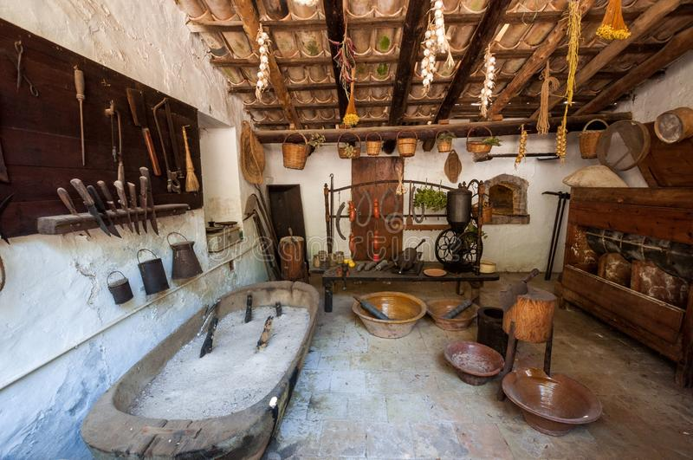
Upon completion of these studies, the remains were given a Catholic burial at the local cemetery. The Pereira family’s upturned floor was filled, and the kitchen was rebuilt.

Slide 11
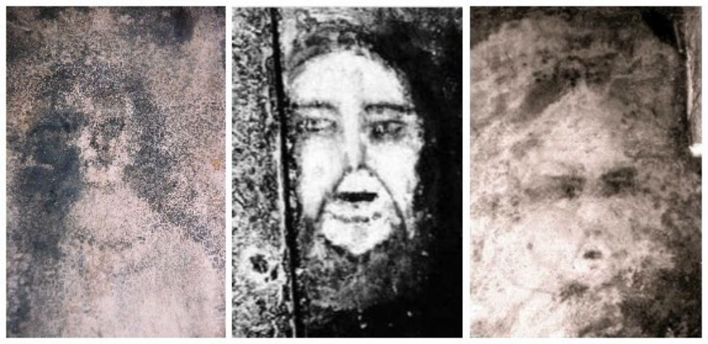
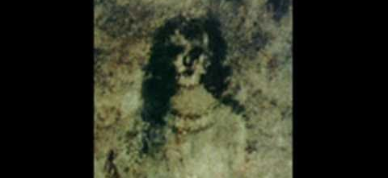
We’re Back!!!
Not long after, new faces emerged.

Slide 12
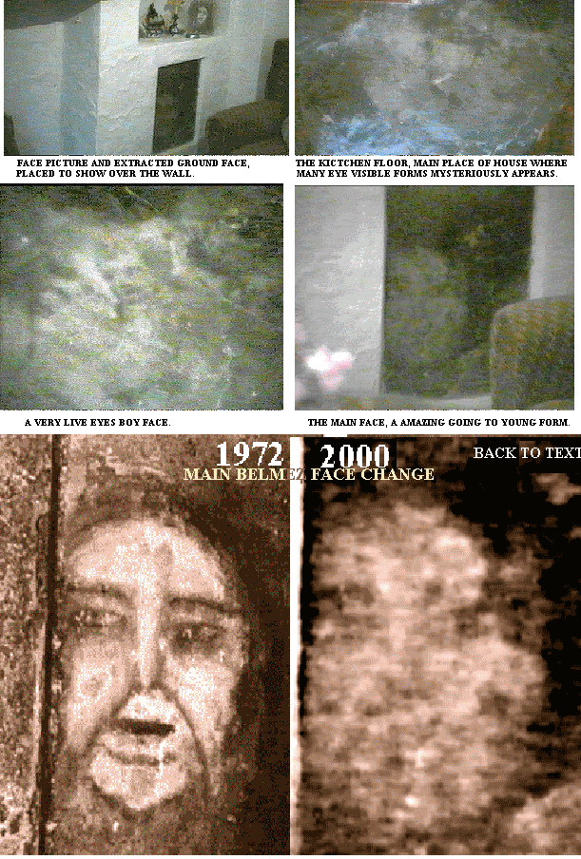
Big News
By now, news of the Bélmez Faces spread well beyond the mountain town, attracting seekers far and wide. Priests, journalists, and paranormal researchers made their way to the once-quiet village in hopes of experiencing the strange visages for themselves. Upon seeing the Bélmez Faces in person, German investigator Dr. Hans Bender declared the phenomenon the most important paranormal occurrence of the 20th century.

Slide 13
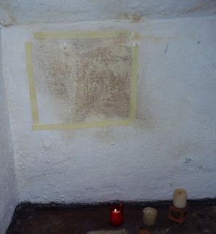
Sealing the Room
A full-scale investigation commenced, spearhead by the Spanish Institute for Ceramics and Glass. Researchers photographed and mapped out the floor of the Pereira home before covering it in cloth and sealing it in wax to prevent tampering. A local notary stood witness as the room was sealed. When they opened the room and uncovered the floor months later, researchers discovered that the faces had indeed moved and transformed.

Slide 14
But the investigation failed to provide an answer as to why the Bélmez Faces lived out their lives in the Pereira home, or where they came from.

Slide 15
It’s Maria’s fault!!!
Numerous hypotheses surfaced, including that the face-like stains were merely the result of chemical agents reacting to light. A paranormal explanation known as the thoughtographic hypothesis held that the Bélmez Faces were a projection of María’s thoughts and emotions. People believed that María’s thoughts generated the expressions upon the floor. They changed with her moods and desires—and would only disappear once María no longer lived in the home.

Slide 16
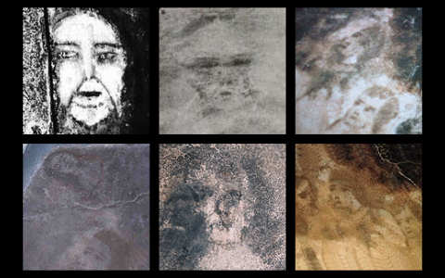
New faces!
In 2004, María died at the age of 85. With her passing, many psychics who believed in the thoughtographic hypothesis predicted that the faces would cease. Yet they continued to appear, along with new ones

Slide 17
The Spanish media remains fascinated by the Bélmez Faces. Some now contend that the entire phenomenon was a hoax carried out by María’s son, Diego.
Whether these mysterious shapes are the pained resemblances of lost souls, the paintings of a con-artist, or just a trick of the imagination is currently unknown.

Slide 18
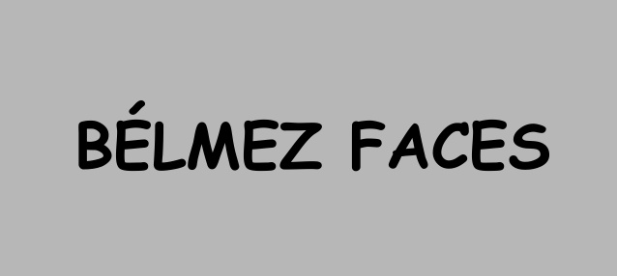
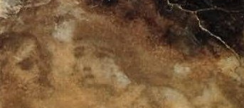
One thing is for certain: The empty eyes of the Bélmez Faces continue to peer up from below.

